Slide 1
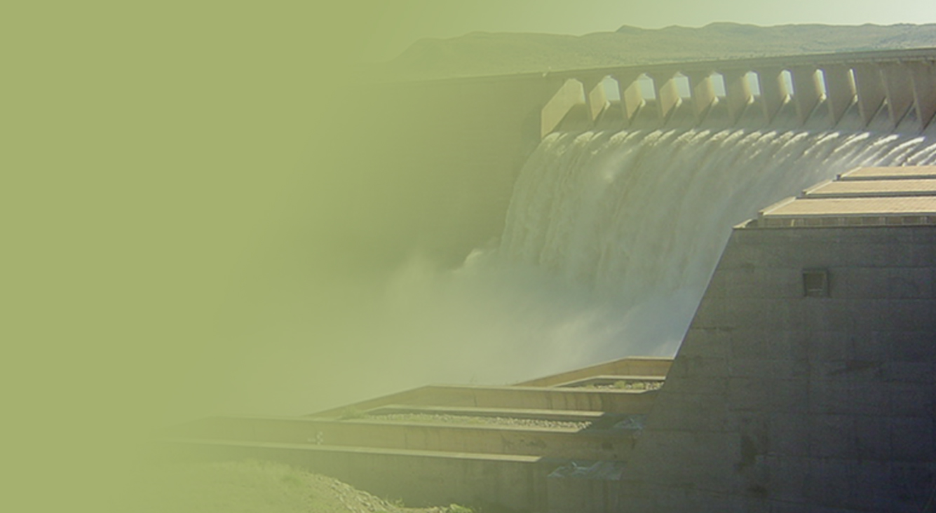
NOORDOEWER / VIOOLSDRIFT DAM FEASIBILITY STUDY
Presented by:
Seef Rademeyer
Department of Water and Sanitation
Date: 27 February 2018
PRESENTATION TITLE
Presented by:
Name Surname
Directorate
Date
1

Slide 2
NOORDOEWER/VIOOLSDRIFT DAM FEASIBILITY STUDY
Main purpose of Study:
Feasibility Design of the Noordoewer/Vioolsdrift Dam (NVD) on Orange River between Namibia & RSA
Purpose of Noordoewer/Vioolsdrift Dam (NVD):
Serve as re-regulating and/or storage dam to improve water resources availability in Lower Orange River, supplying:
Ecological water requirements (EWRs) of the Orange River and Estuary
Domestic water requirements
Industrial water requirements
Mining water requirements
Irrigation water requirements

Slide 3
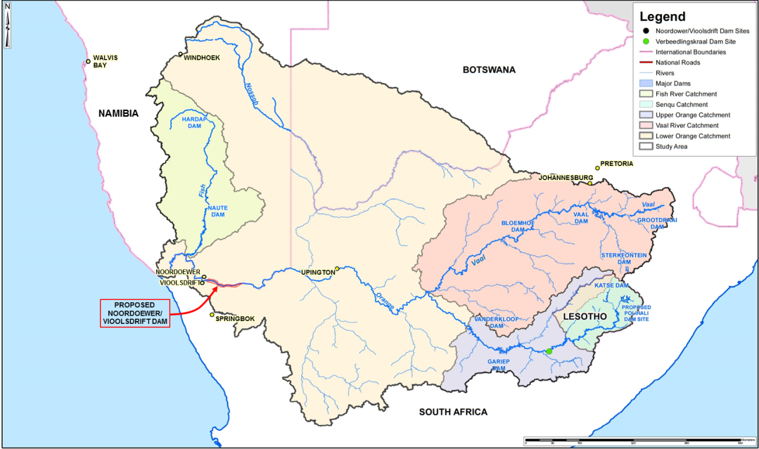
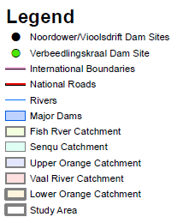
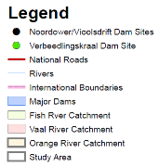
STUDY AREA
STUDY AREA
Windhoek
Hardap
Dam
Pretoria
Johannesburg
Neckartal
Dam
Neckartal
Dam
Keetmanshoop
Naute
Dam
Vaal
Dam
Bloemhof
Dam
Grootdraai
Dam
Welkom
Sterkfontein
Dam
Noordoewer
Upington
Vioolsdrift
Katse Dam
Noordoewer /
Vioolsdrift Dam
site
Maseru
Polihale
Dam site
Springbok
Vanderkloof
Dam
Gariep
Dam
Verbeeldingskraal Dam site

Slide 4
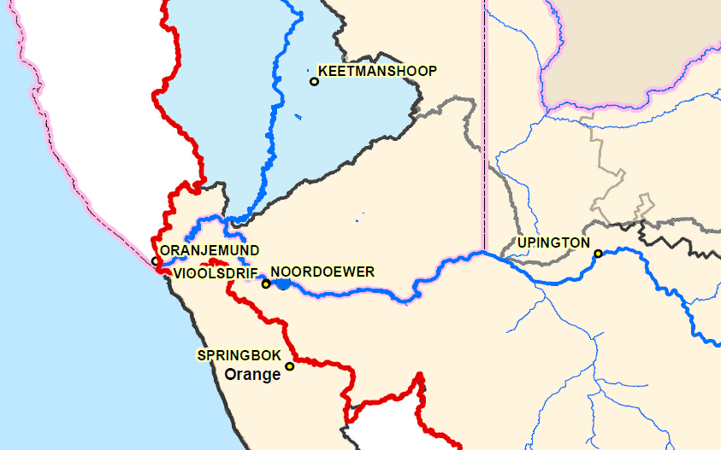
LOWER ORANGE RIVER
Namibia
NOORDOEWER
NOORDOEWER/
VIOOLSDRIFT
DAM SITE
South Africa
4

Slide 5
PURPOSE OF THE STUDY
Main study objectives
Update the water requirement projections in Orange River System
Determine optimum site and size for NVD
Finalise purpose and timing of NVD for re-regulation, for larger storage and/or for both in single/phased approach
Determine timing and most appropriate development option after NVD
Conduct feasibility study on selected NVD site and size to ensure technical, financial, operational and institutional feasibility
Conduct Environmental Impact Assessment (EIA) to ensure environmental and social feasibility

Slide 6
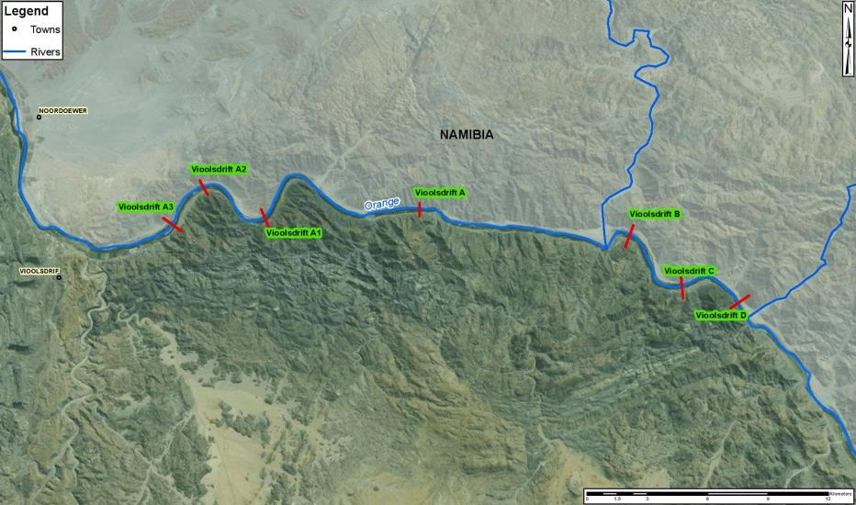
POSSIBLE NVD SITES
B1
NOORDOEWER
Site A3
VIOOLSDRIFT
Selected for further investigation
7

Slide 7
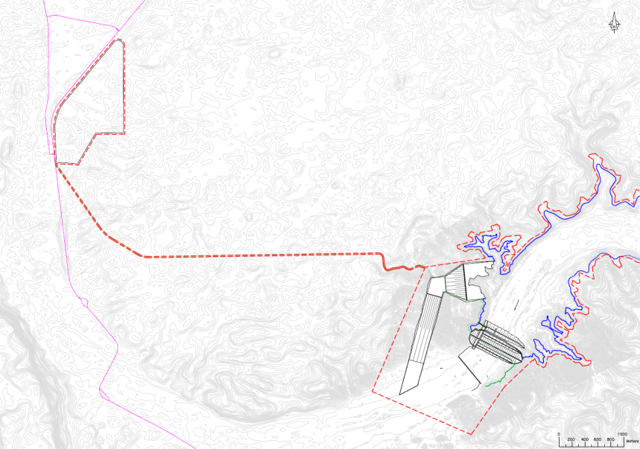
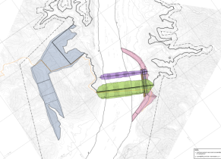
GENERAL PROJECT LAYOUT
B1
Noordoewer
C13
Residential and
operational office area
NAMIBIA
NVD area border
NVD international
operational area border
B1
Access road
Namibia border
post
Side spillway
NVD embankment
NVD international
operational area border
Hydropower house
RSA border
post
Flow gauging weir
Vioolsdrift
N7
RSA
Orange River

Slide 8
OPTIMUM NOORDOEWER/VIOOLSDRIFT DAM SIZE
Alternative dam development options
Fish River
Option 1
Noordoewer/
Vioolsdrift Dam
Vaal River
Vanderkloof
Dam
Gariep
Dam
LHWP-1
Estuary
5
4
3
2
Polihali
Dam
73.5 m / 2 800 million m³
Option 2
Fish River
Vaal River
Noordoewer/
Vioolsdrift Dam
Vanderkloof
Dam
Gariep
Dam
Verbeeldingskraal Dam
LHWP-1
Estuary
5
4
3
2
Polihali
Dam
41 m / 645 million m ³
95 m / 2 117 million m ³

Slide 9
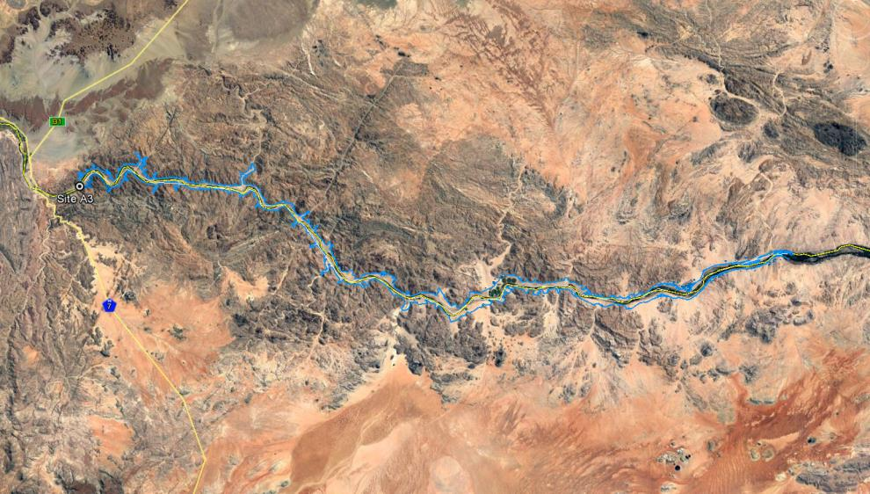
AREA TO BE INUNDATED BY OPTION 1
Haib River
Noordoewer
Option 1
95 km
Vioolsdrift
FSL/area
inundated
Witbank
Henkries
absrtaction
Goodhouse
Area to be inundated = 122 km²
9

Slide 10
AREA TO BE INUNDATED BY OPTION 2
Haib River
Noordoewer
Option 2
50 km
Vioolsdrift
FSL/area
inundated
Witbank
Henkries
absrtaction
Goodhouse
Area to be inundated = 43 km²
10

Slide 11
OPTIMUM NOORDOEWER/VIOOLSDRIFT DAM SIZE
Alternative dam development options
Option | Option 1 | Option 2
Implementation/commissioning | 2024 | 2024
NVD height to full supply level (FSL) | 70.0 m | 41.5 m
NVD capacity | 2 800 million m³ | 645 million m³
Yield benefit @ 2024 | 666 million m³/a | 408 million m³/a
Implementation date of next scheme (Verbeeldingskraal Dam) | 2045 (21 years after NVD) | 2032* (8 years after NVD)
Benefit-cost ratio (6% discount rate) | 1.34 | 1.50
Hydropower generation at NVD | 17 MWc | 8 MWc
Additional hydropower generation in ORS | 12 MWc | 50 MWc
* No feasibility study conducted yet for Verbeeldingskraal Dam

Slide 12
OPTIMUM NOORDOEWER/VIOOLSDRIFT DAM SIZE
Other practical considerations
Verbeeldingskraal Dam
To implement will take about 15 years to go through feasibility (including assessment of EWRs), design and construction phases
Separate EIA process required
Flooding of Lesotho area – negotiation period
Raise capital for 2 large dams
Cost apportionment negotiations with Namibia for all dams
URV for Verbeeldingskraal Dam is lower than raising of Gariep Dam

Slide 13
CONCLUSIONS
Study to be finalised regarding the best option (NVD size) for implementation
Engagement currently underway between South Africa and Namibia on the optimum development option
EIA to be conducted as per chosen best development option

Slide 14
.
THANK YOU

